Slide 1
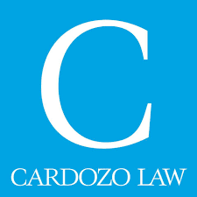
A Practical Guide to Patents
Patent Diversity Project at Cardozo Presents:

Slide 2
Disclaimer: Not Tax or Legal Advice
This presentation is current as of April 21, 2021. The contents of this presentation and the topics we discuss today are not comprehensive, should not be construed as legal or tax advice, and should not substitute for a consultation with an attorney and/or an accountant. Nothing in this presentation creates an attorney-client relationship with Start Small Think Big or Cardozo Law School. These materials are for educational purposes only.
This presentation is proprietary and is being recorded. It may not be reproduced or distributed without prior written consent of Start Small Think Big and Cardozo Law School.

Slide 3
Start Small Think Big: Overview
Who We Are
Start Small Think Big believes that access to high-quality legal, financial management, and marketing services is an essential part of starting or growing a successful small business. We are a nonprofit organization and focus on pairing entrepreneurs positioned to grow their businesses with top pro bono attorneys and financial and marketing experts.
Who We Serve
We work with under-resourced small business owners.

Slide 4
Start Small Think Big: What We Offer
Legal
Provide access to Legal information and assistance through tailored referrals to volunteer pro bono attorneys
Volunteer attorneys address clients’ legal needs (business entity formation, corporate governance guidance, contract review and drafting, commercial lease review, intellectual property issues, employment law matters, etc.)
Business & Financial
Provide access to in-house and/or pro bono financial advisors for assistance with small business financial management (bookkeeping advice, business and financial modeling, etc.), and hands-on workshops
Marketing
Provide access to in-house and/or pro bono marketing advisors for assistance with marketing strategy, website and brand assessment, social media strategy, online advertising, and hands-on workshops
Connect clients to online and/or in-person vending opportunities such as tastings, pop up shops, markets and fairs, business-to-business sales, etc.

Slide 5
Start Small Think Big: What We Offer
COVID-19 Rapid Response Program (RRP)
FAST TRACK, WALK-IN STYLE SUPPORT
For small business impacted by COVID-19 and in need of immediate assistance, we offer help with contract and legal compliance issues, loan/grant applications, financial statement review, website audit, etc.
RRP ASSISTANCE REQUEST FORM
Available at covid19.startsmallthinkbig.org/request

Slide 6
Start Small Think Big: Client Eligibility Criteria
Eligible Business Stage and Size
Currently selling goods and/or services (sales over the past 3 months of at least $500) OR have a legal impediment that is keeping them from doing so
Where sales have dropped because of COVID-19 crisis, we consider evidence of sales during the 3 months prior to March 2020
No more than $1M in business revenue over previous 12 months
Eligible Under-Resourced Business Owners
Household income generally less than 500% of the Federal Poverty Guidelines
Household assets generally less than $50,000
Focus on entrepreneurs from traditionally under resourced communities (identifying for example as people of color, immigrants, women, LGBTQ+, with disability, veterans, etc.) and small businesses helping to create jobs in or provide services to under-resourced communities

Slide 7
Patent Diversity Project at Cardozo School of Law
Founded with a grant by Google in 2018
Operates with Tech Startup Clinic
Provides:
Patent and trademark guidance
Pro bono attorney referrals
Patentability and clearance search
Provisional patent application drafting

Slide 8
Agenda
Intellectual Property Overview
Patent Basics
Pre-Filing Considerations
Patent Prosecution Process
Post-Grant Considerations

Slide 9
Intellectual Property (IP) Overview
1

Slide 10
What is Intellectual Property?
IP Overview
Intellectual property (IP) refers to creations of the mind.
IP Protection:
Copyright
Trademark
Patent
Trade Secret

Slide 11
Copyright
IP Overview
Rights that creators have over their literary and artistic works.
Term: The life of the author plus 70 years (95 years from first publication for some)

Slide 12
Trademark
IP Overview
Word, phrase, symbol, and/or design that identifies and distinguishes the source of the goods of one party from those of others.
Term: So long as business continuously uses trademark in connection with goods or services

Slide 13
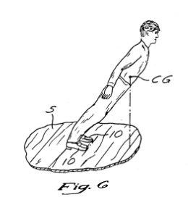
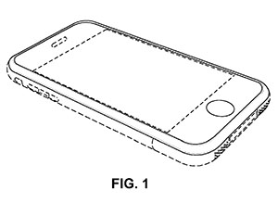
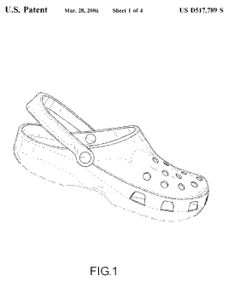
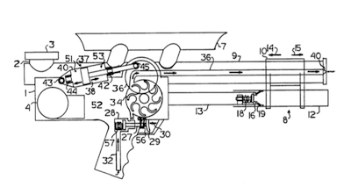
Patent
IP Overview
Patent grants “the right to exclude others from making, using, offering for sale, or selling” the invention in the United States or “importing” the invention into the United States.
Term: 20 years, 15 years for design

Slide 14
Trade Secret
IP Overview
Formulas, methods, devices or compilations of information which is confidential and gives a business an advantage
Examples: Coca‐Cola formula, new invention for which patent application has not been filed
Term: So long as information remains confidential and functions as a trade secret

Slide 15
IP Protection Overview
IP Overview
Brand | Product |  | Secret
Does the IP help people identify the source of the good? | Is it functional? Is it an ornamental design? Is it a plant? | Is it creative? Is it fixed to a medium? | Does it have economic value? Do you make an effort to keep it a secret?
Trademark | Patent | Copyright | Trade Secret

Slide 16
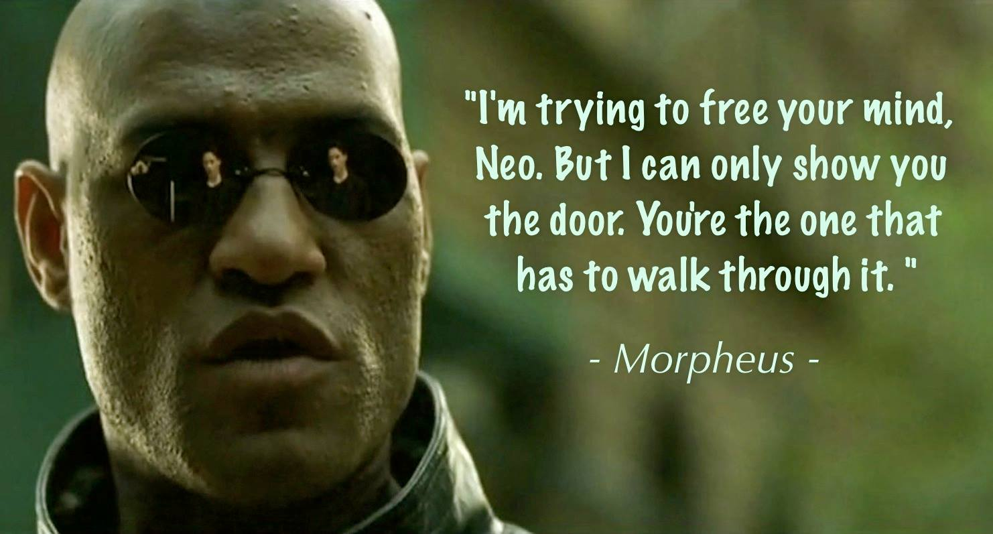

Slide 17
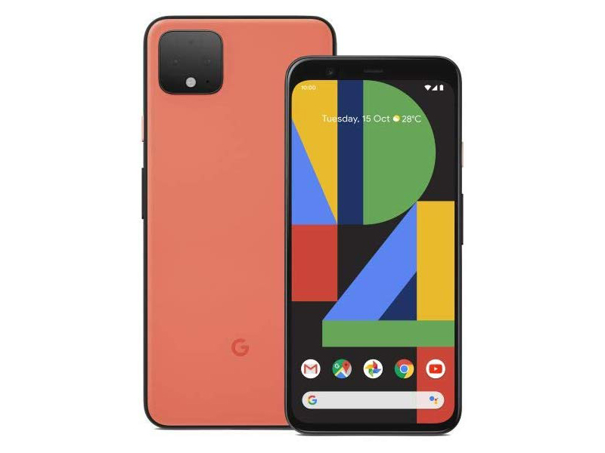
Recognizing IP
IP Overview
Trademarks
Patents
Design
Utility
Copyrights
Trade Secrets

Slide 18
Patent Basics
2

Slide 19
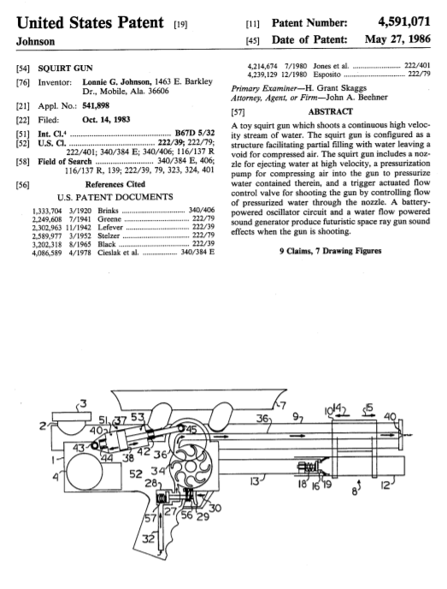
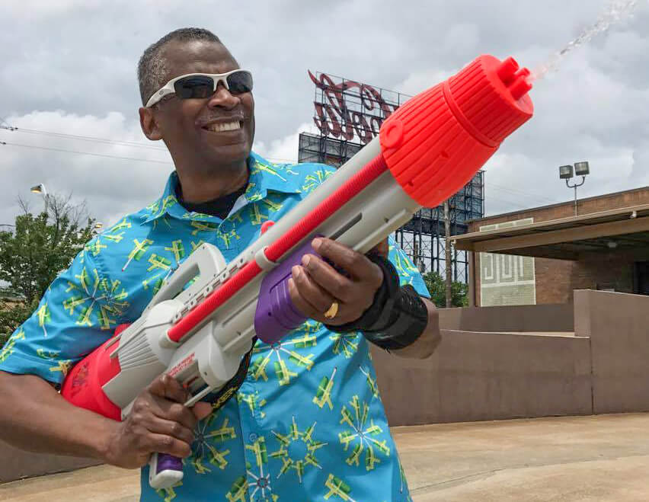
What is a patent?
2. Patent Basics

Slide 20
What is a patent?
2. Patent Basics
“The right to exclude others from making, using, offering for sale, or selling” the invention in the United States or “importing” the invention into the United States.
Right to Exclude

Slide 21
What is a patent?
2. Patent Basics
Right to Exclude
Right to Exclude | Right to Make

Slide 22
What is a patent?
2. Patent Basics
Right to Exclude
Right to Exclude | Right to Make

Slide 23
What is a patent?
2. Patent Basics
Idea
Invention
Patent
Right to Exclude
Patent protects an invention, not an idea

Slide 24
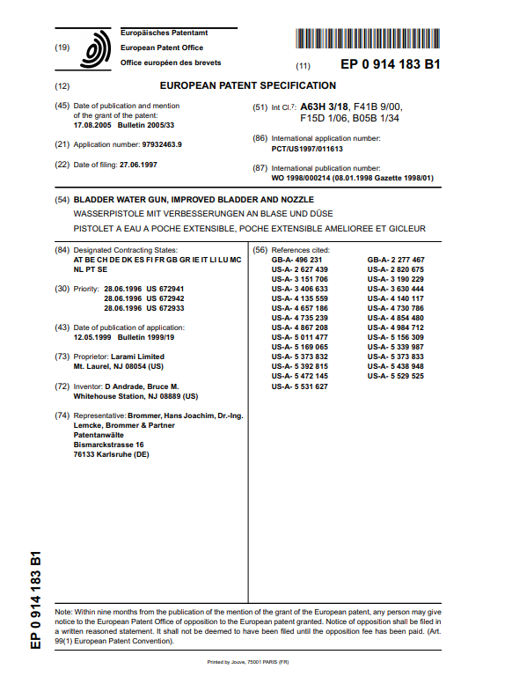
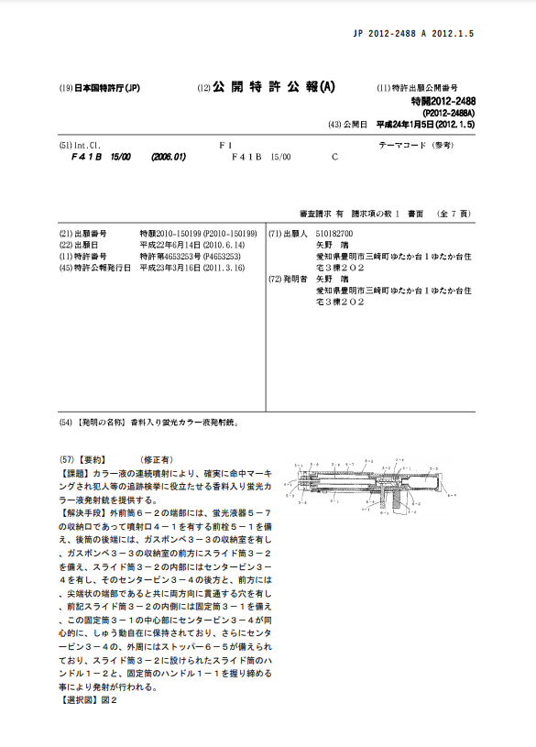
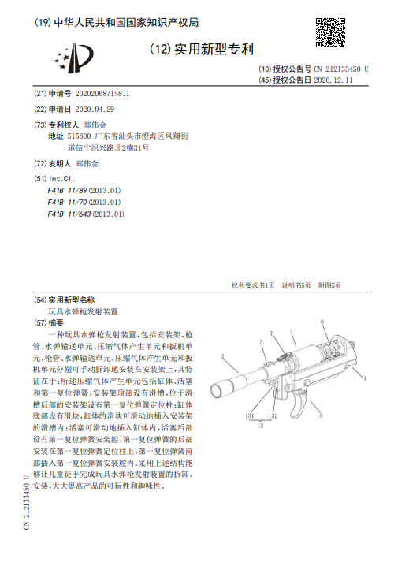
What is a patent?
2. Patent Basics
Right to Exclude
Patent protects an invention, not an idea
Territorial

Slide 25
What is a patent?
2. Patent Basics
Utility | Design | Plant
Protects “functional” invention. | Protects “ornamental design.” | Protects New variety of asexually propagated plant
20 year term | 15 year term | 20 year term
Expensive | Inexpensive | Moderate
Potentially broad protection | Narrow protection | Narrow protection
Right to Exclude
Patent protects an invention, not an idea
Territorial
3 types of patents

Slide 26
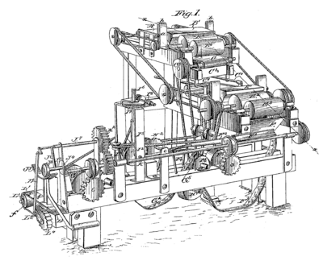
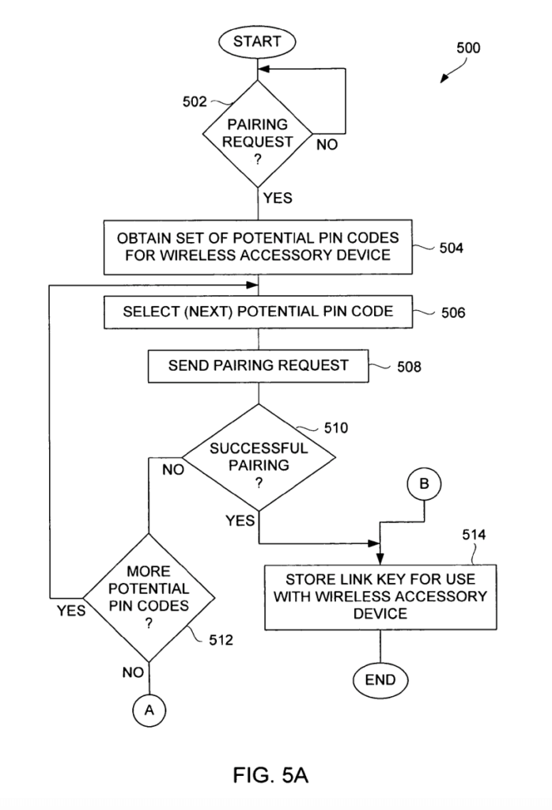
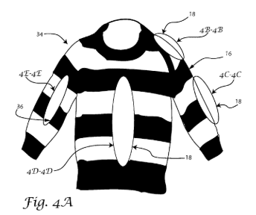
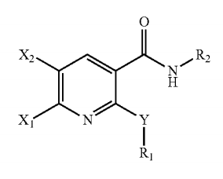
Patents (Utility, Design, Plant)
IP Overview
Right to Exclude
Patent protects an invention, not an idea
Territorial
3 types of patents
Utility Patent

Slide 27
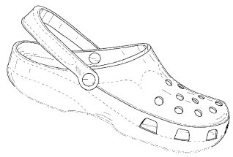
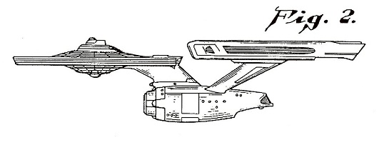
Patents (Utility, Design, Plant)
1. Recognizing IP
Right to Exclude
Patent protects an invention, not an idea
Territorial
3 types of patents
Design Patent

Slide 28
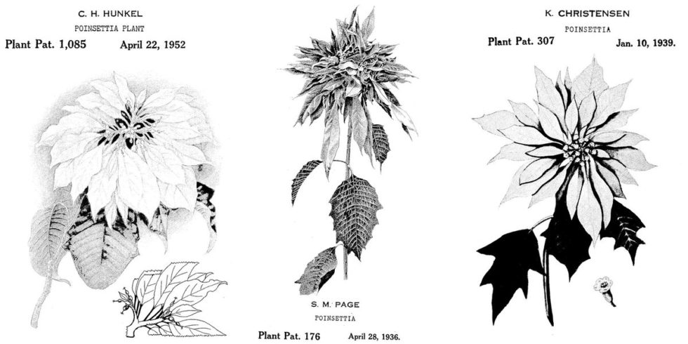
Patents (Utility, Design, Plant)
1. Recognizing IP
Right to Exclude
Patent protects an invention, not an idea
Territorial
3 types of patents
Plant Patent

Slide 29
What is a patent?
2. Patent Basics
Patent generally includes:
Title
Abstract
Drawings
Specification
Claims
Right to Exclude
Patent protects an invention, not an idea
Territorial
3 types of patents
A legal document

Slide 30
What is a patent?
2. Patent Basics
Patent generally includes:
Title
Abstract
Drawings
Specification
Claims

Slide 31
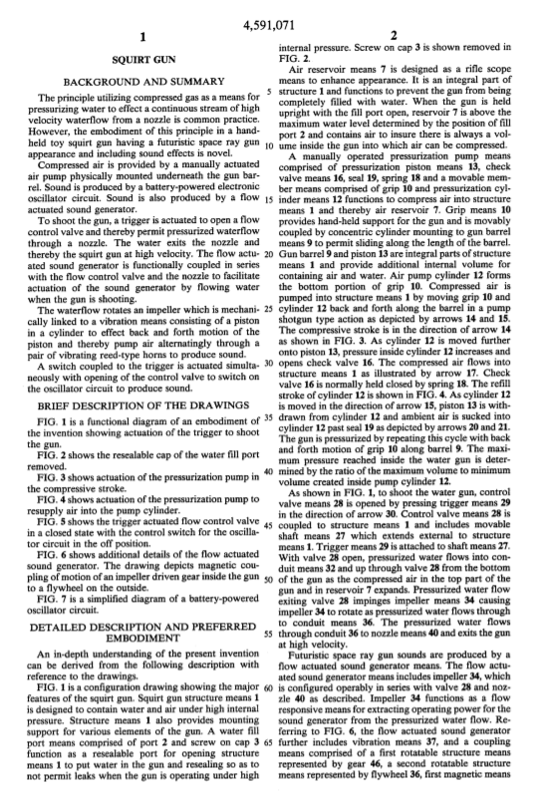
What is a patent?
2. Patent Basics
Patent generally includes:
Title
Abstract
Drawings
Specification
Claims

Slide 32
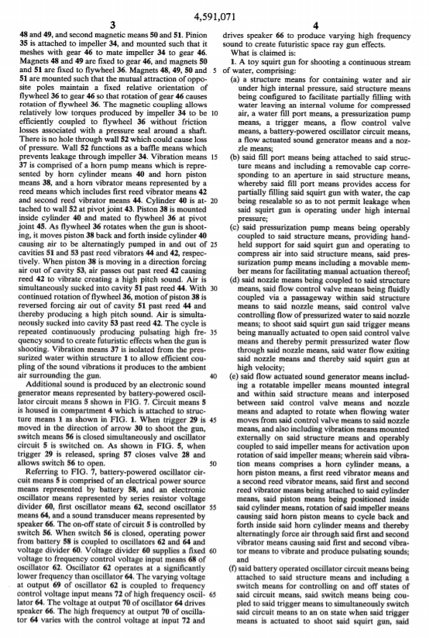
What is a patent?
2. Patent Basics
Patent generally includes:
Title
Abstract
Drawings
Specification
Claims

Slide 33
What is a patent?
2. Patent Basics
Claim:
A toy squirt gun for shooting a continuous stream of water, comprising:
(a) a structure means for containing water and air under high internal pressure, said structure means being configured to facilitate partially filling with water leaving an internal volume for compressed air, a water fill port means, a pressurization pump means, a trigger means, a flow control valve means, a battery-powered oscillator circuit means, a flow actuated sound generator means and a nozzle means…
Right to Exclude
Patent protects an invention, not an idea
Territorial
3 types of patents
A legal document
Name of the game is in the claim

Slide 34
What is a patent?
2. Patent Basics

Slide 35
What is a patent?
2. Patent Basics
Right to Exclude
Patent protects an invention, not an idea
Territorial
3 types of patents
A legal document
Name of the game is in the claim

Slide 36
Pre-Filing Considerations
3

Slide 37
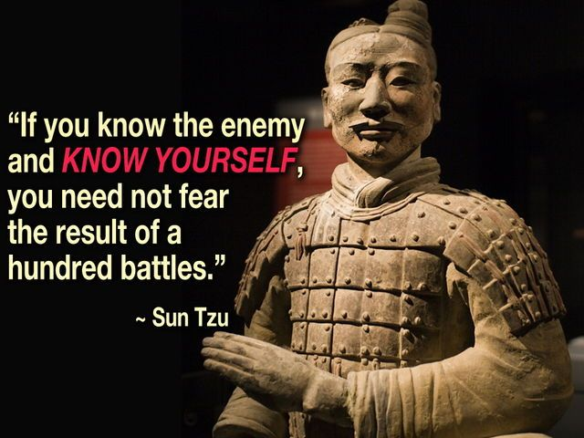
Pre-Filing Considerations

Slide 38
Pre-Filing Considerations
Idea vs. Invention
Patentability Search
Clearance Search
Patent Eligibility
Cost / Budget
Other Considerations

Slide 39
Idea vs. Invention
Pre-filing Considerations
“Patent cannot be obtained upon a mere idea or suggestion.”
Attorneys cannot help you invent – inventorship issues.
Complete description of the actual machine or invention is required.

Slide 40
2. Patentability search
Pre-filing Considerations
Goal: Determine if you can patent your product
Novelty
Obviousness
Can be done by attorneys, search firms, students at patent diversity project

Slide 41
3. Clearance search
Pre-filing Considerations
Goal: Determine if your product has been patented by others
Search patents and claims only
Can be done by attorneys, search firms, students at patent diversity project

Slide 42
4. Patent Eligibility
Pre-filing Considerations
Goal: Determine if product is patentable
Not patentable:
Abstract Idea (software)
Law of Nature
Natural Phenomenon
Rule of thumb – if it can be touched, it’s likely patentable

Slide 43
4. Patent Eligibility
Pre-filing Considerations
Class 023 – Chemistry
Class 446 – Toys
Class 706 – Artificial Intelligence
Class 705 – Business Methods

Slide 44
5. Cost v. Budget
Pre-filing Considerations
Goal: Determine if patent filing makes a sound business decision
Type of Invention | Examples | Attorneys Fees to Filing | Patent Search with Opinion
Extremely Simple | coat hanger; paper clip; earmuffs; ice cube tray | $5,000 to $7,000 | $1,000 to $1,250
Moderately Complex | lawn mower; simple RFID devices; cell phone | $10,000 to $12,000 | $1,500 to $1,750
Highly Complex | MRI scanner; telecommunication networking systems; satellite technologies | $14,000 to $16,000 | $2,000 to $2,500
Software Related | Software, automated systems, business methods | $16,000 + | $2,500 to $3,000
Source: https://www.ipwatchdog.com/2015/04/04/the-cost-of-obtaining-a-patent-in-the-us/id=56485/

Slide 45
6. Other Considerations
Pre-filing Considerations
Alternative IP: Trade Secret
Global Approach
Disclosure
Founders – your idea vs. work idea
NDA / confidentiality

Slide 46
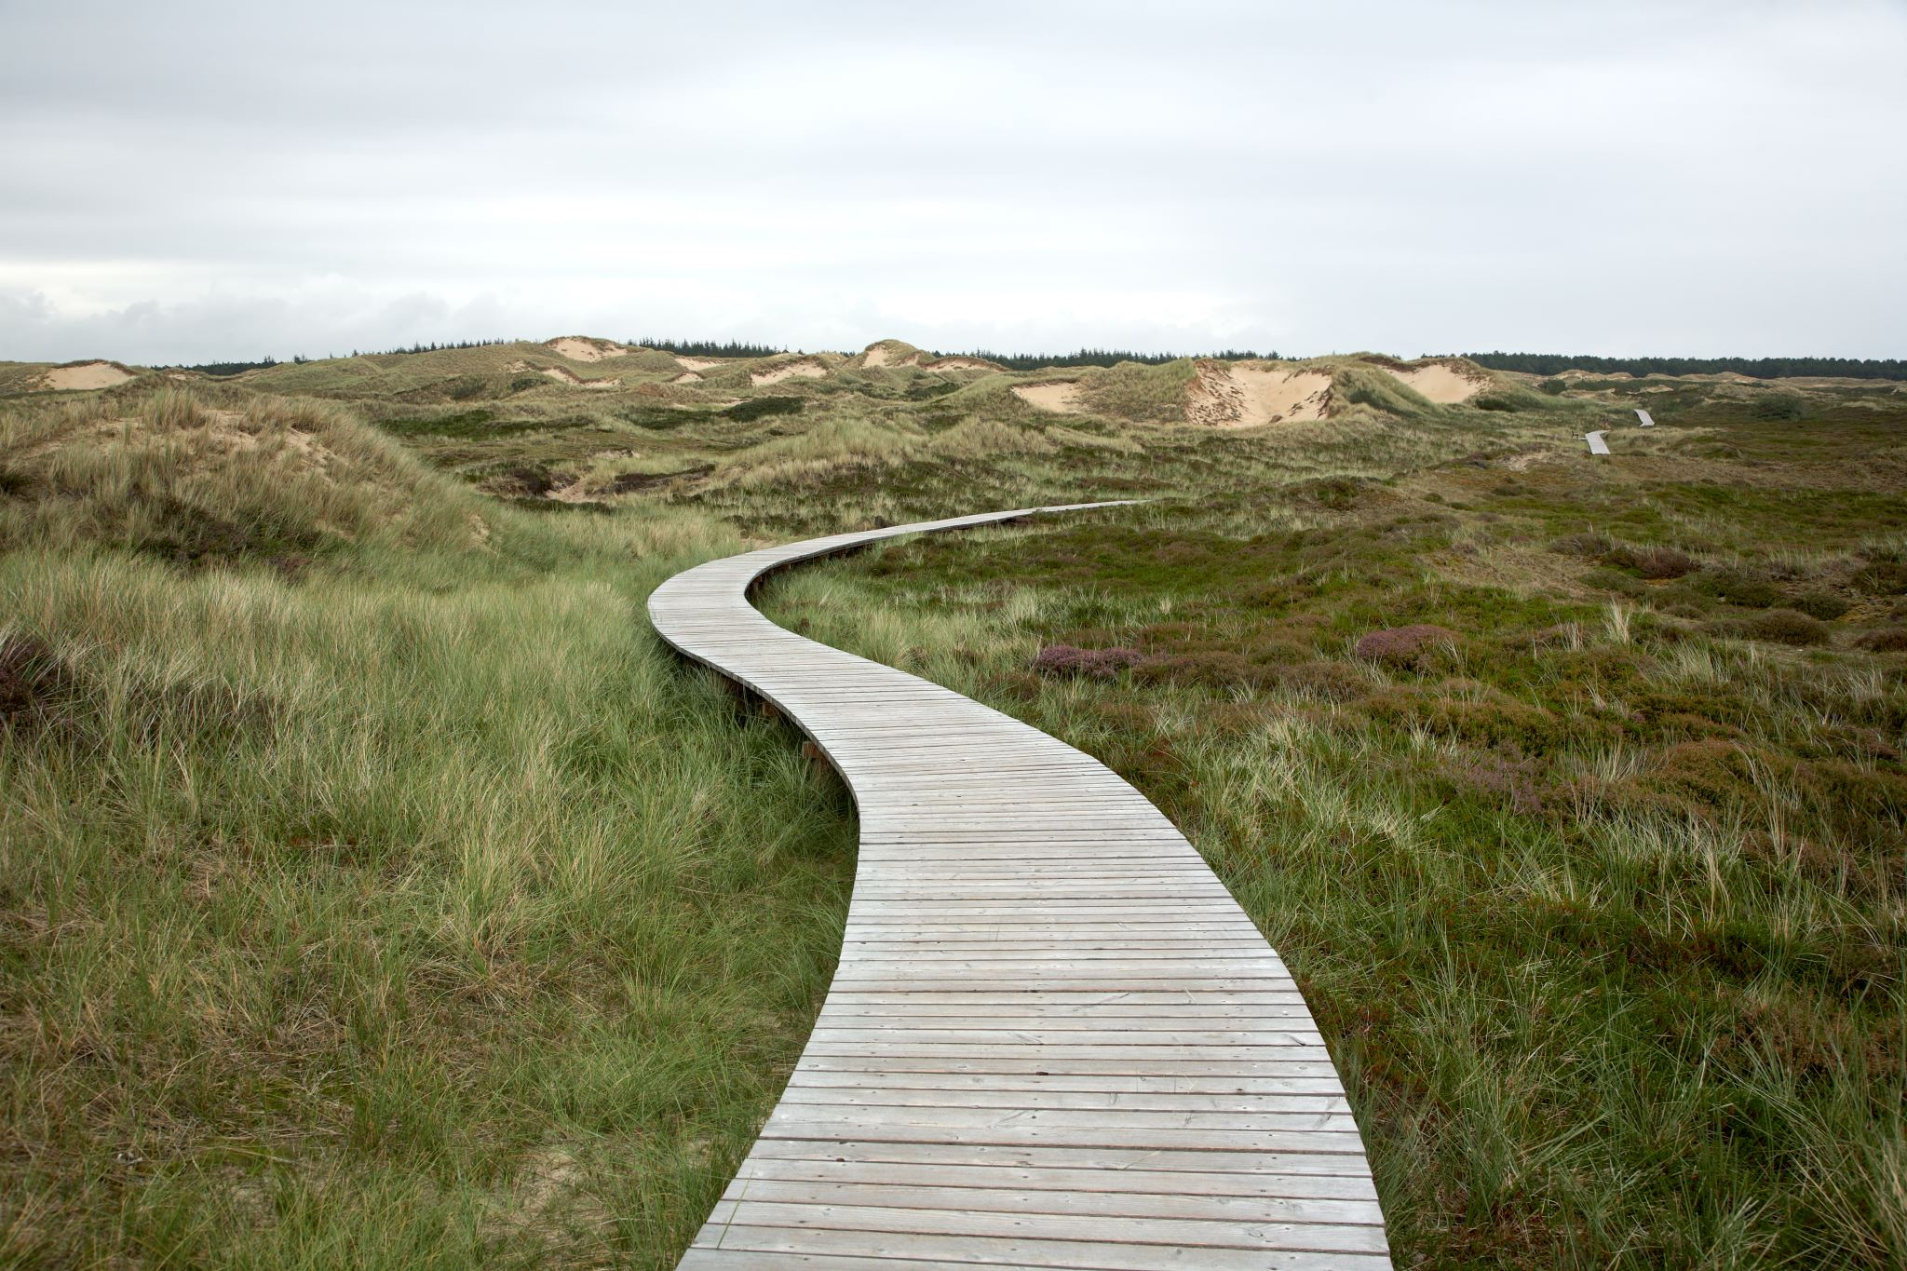
Patent Prosecution Process
4

Slide 47
Overview
Patent Prosecution
Consultation
Prepare and File Application
Office Action
Response
Issue
Appeal
Abandon

Slide 48
Consultation
Patent Prosecution
Idea vs Invention
Functional vs. Design
Fees
Patent eligibility
Patentability
Conflicts
Comfort with tech
Consultation

Slide 49
Consultation
Patent Prosecution
Pro Se
Patent Attorney (Pro Bono)
Patent Agent
Consultation

Slide 50
Drafting and Filing
Patent Prosecution
Utility Patent Application
Provisional
Non-provisional
Design Patent Application
Consultation
Prepare and File Application

Slide 51
Drafting and Filing
Patent Prosecution
Utility Patent Application
Provisional
Non-provisional
Design Patent Application
Consultation
Prepare and File Application

Slide 52
Drafting and Filing
Patent Prosecution
Provisional Application
Pros:
Comparatively low-cost ($120-330 official fees)
Establishes filing date
“Patent pending”
Confidential
Cons:
Not examined - Does not become a patent
Automatically abandoned at 12 months

Slide 53
Drafting and Filing
Patent Prosecution
Non-provisional Application
Pros:
May become a patent
“Patent pending”
Credibility
Cons:
Expensive.
Note: Published after 18 months

Slide 54
Prosecution at the USPTO
Patent Prosecution
Negotiation with the USPTO
Interview
Discuss differences between reference and application
Present amendments
Consultation
Prepare and File Application
Office Action
Response

Slide 55
Prosecution at the USPTO
Patent Prosecution
Length of Prosecution
Utility patents – average ~30 months for total pendency
Design patents – average ~13 months
Consultation
Prepare and File Application
Office Action
Response
Issue
Appeal
Abandon

Slide 56
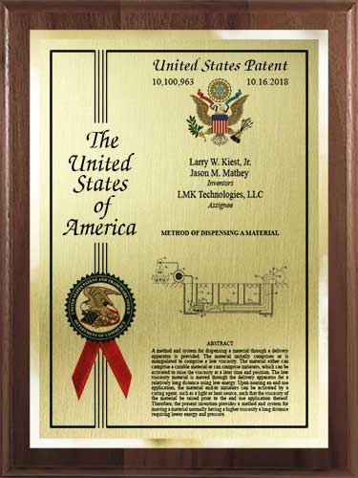

Slide 57
Post Grant Considerations
5

Slide 58
Costs
Post Grant Consideration
Maintenance Fees
Description | Fee | Small entity fee | Micro entity fee
For maintaining an original or any reissue patent, due at 3.5 years | 2,000.00 | 1,000.00 | 500.00
For maintaining an original or any reissue patent, due at 7.5 years | 3,760.00 | 1,880.00 | 940.00
For maintaining an original or any reissue patent, due at 11.5 years | 7,700.00 | 3,850.00 | 1,925.00

Slide 59
Patent Monetization
Post Grant Consideration
Licensing
Assignment
Litigation
Factors for Monetization
Technology
Market
Claim breadth
Number of patents in portfolio

Slide 60
How we can help
Lower cost of entry
Patentability search
Drafting referrals
Provisional patent drafting
Consultation and information
Patent filing guidance
Clearance search

Slide 61
We’re here to help YOU!
Victor.Wang@yu.edu

